Slide 1
Fusion: GPU Accelerated PBD Simulator for Unity
Milestone 1
Team Jiethan: Jie Meng and Yichen (Ethan) Shou

Slide 2
Project Overview
Physics simulator in Unity
Basic goal: cloth simulator
Stretch goal: rigid-body and fluid simulator
Use Unity’s built in Compute Shaders for GPU acceleration

Slide 3
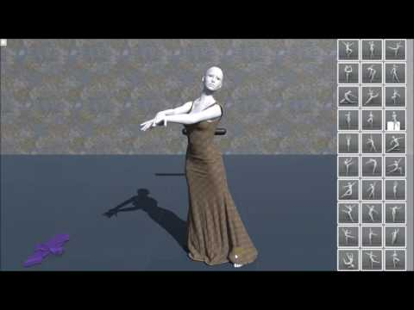
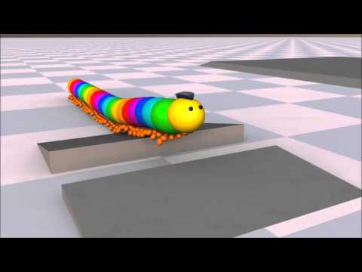
Inspirations/Goals

Slide 4
Why Position Based Dynamics?
Not physically accurate but very fast
Uses inter-particle “constraints” to simulate physics
Very flexible
Originally made for cloth
Newer methods simulates soft-body and fluids too

Slide 5
Progress So far

Slide 6
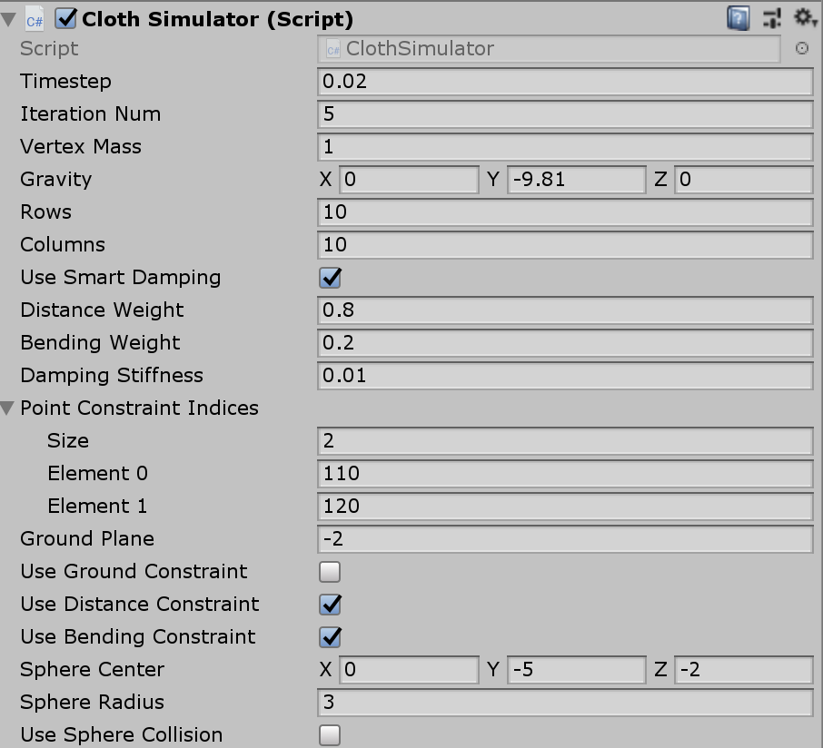

Slide 7


Slide 8
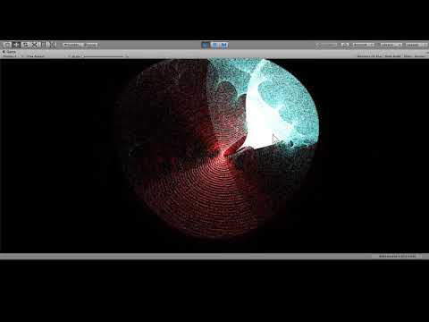

Slide 9
Project Roadmap
Milestone 1 (DONE)
Make a simple CPU-based PBD Cloth Simulator
Learn Unity’s compute shaders and make a test project
Milestone 2
Port CPU cloth simulator into GPU
Update simulator with modern techniques and collision-handling
Milestone 3
Implement new constraints to handle soft-body and/or fluid simulation
Build an easy-to-use interface for the tool in the Unity engine
Milestone 4
Combine cloth, soft-body and/or fluid simulation into a single solver and interface

Slide 10
Thanks for your time!

